Slide 1
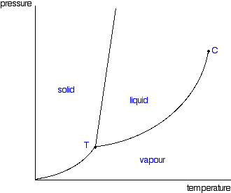
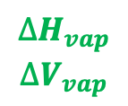
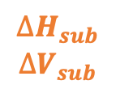
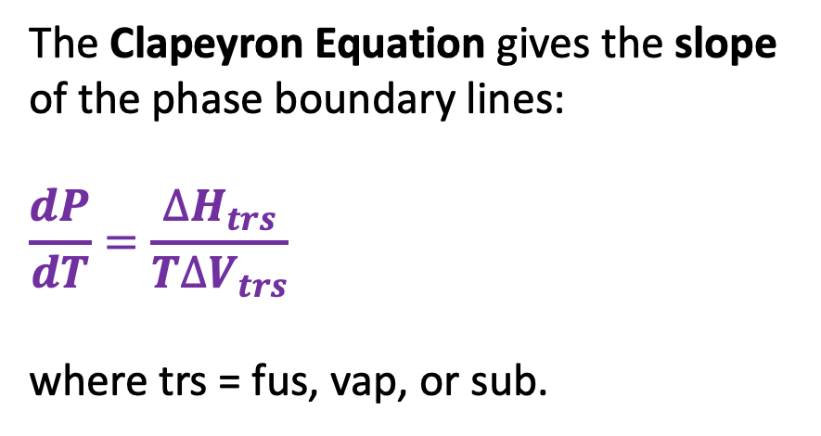
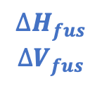
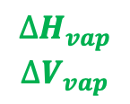
Recap: The Clapeyron equation
The Clapeyron Equation gives the slope of the phase boundary lines:
$$\frac{dP}{dT}=\frac{∆H_{trs}}{T∆V_{trs}}$$
where trs = fus, vap, or sub.
$$∆H_{fus}$$
$$∆V_{fus}$$
P
$$∆H_{vap}$$
$$∆V_{vap}$$
$$∆H_{vap}$$
$$∆V_{vap}$$
$$∆H_{sub}$$
$$∆V_{sub}$$
T

Slide 2
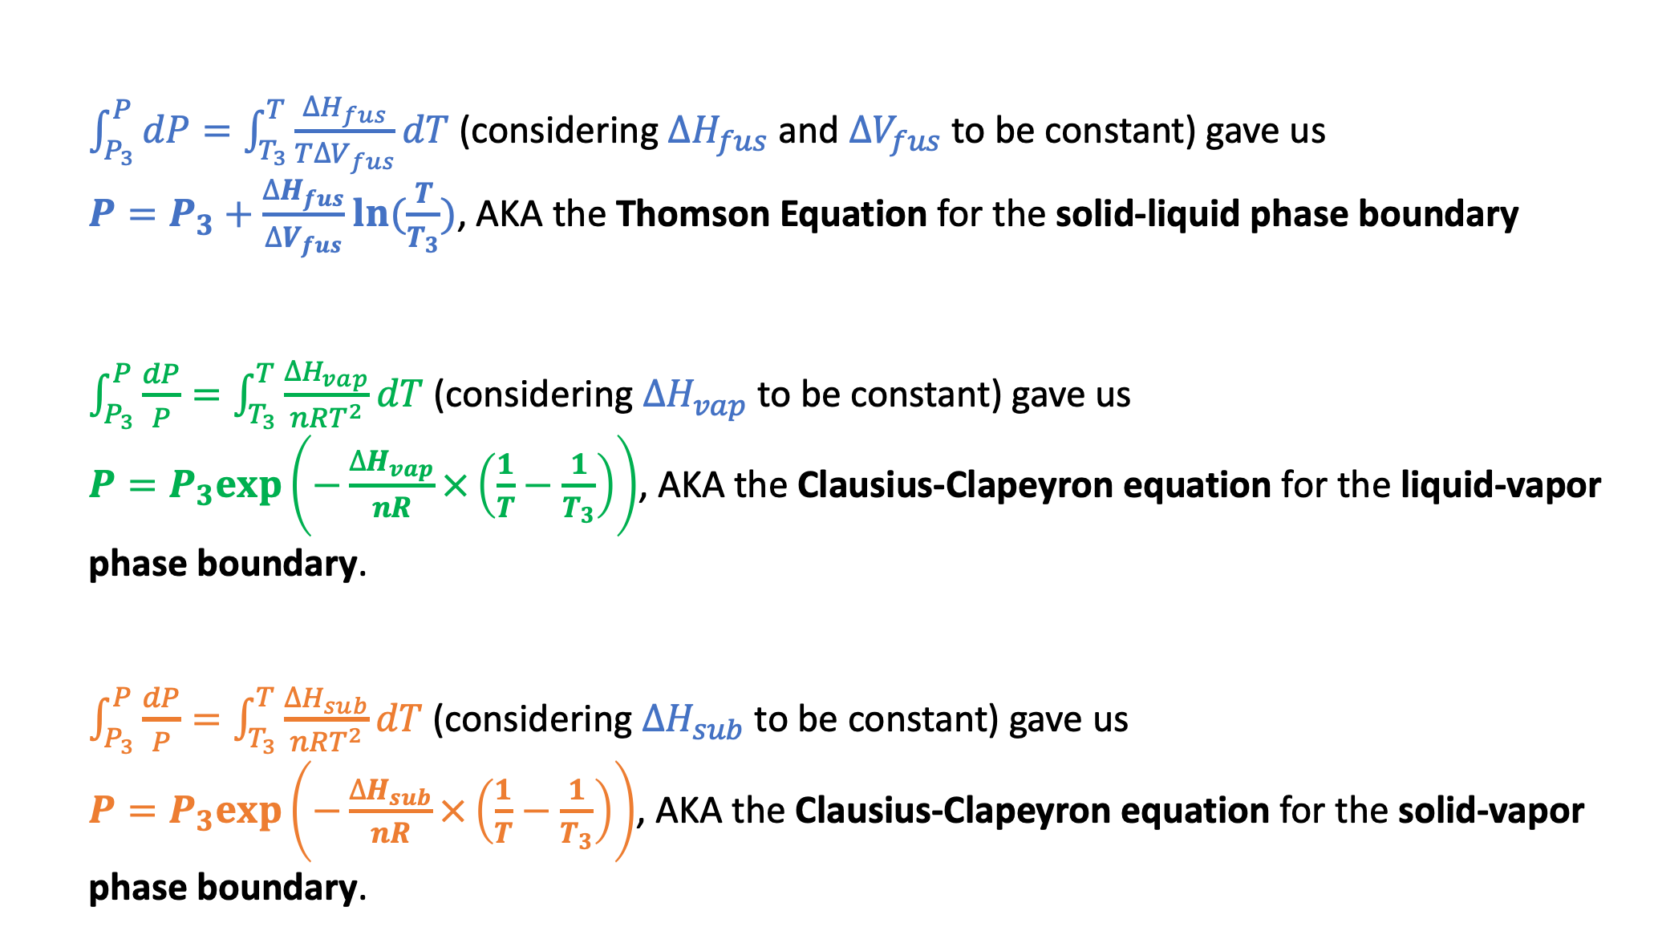
Recap: How Clapeyron integrated to Thomson and Clausius-Clapeyron
$\int_{P_{3}}^{P}{dP}=\int_{T_{3}}^{T}{\frac{∆H_{fus}}{T∆V_{fus}}dT}$ (considering $∆H_{fus}$ and $∆V_{fus}$ to be constant) gave us
$P=P_{3}+\frac{∆H_{fus}}{∆V_{fus}}ln⁡(\frac{T}{T_{3}})$, AKA the Thomson Equation for the solid-liquid phase boundary
$\int_{P_{3}}^{P}{\frac{dP}{P}}=\int_{T_{3}}^{T}{\frac{∆H_{vap}}{nRT^{2}}dT}$ (considering $∆H_{vap}$ to be constant) gave us
$P=P_{3}exp⁡\left(−\frac{∆H_{vap}}{nR}×\left(\frac{1}{T}−\frac{1}{T_{3}}\right)\right)$, AKA the Clausius-Clapeyron equation for the liquid-vapor phase boundary.
$\int_{P_{3}}^{P}{\frac{dP}{P}}=\int_{T_{3}}^{T}{\frac{∆H_{sub}}{nRT^{2}}dT}$ (considering $∆H_{sub}$ to be constant) gave us
$P=P_{3}exp⁡\left(−\frac{∆H_{sub}}{nR}×\left(\frac{1}{T}−\frac{1}{T_{3}}\right)\right)$, AKA the Clausius-Clapeyron equation for the solid-vapor phase boundary.

Slide 3
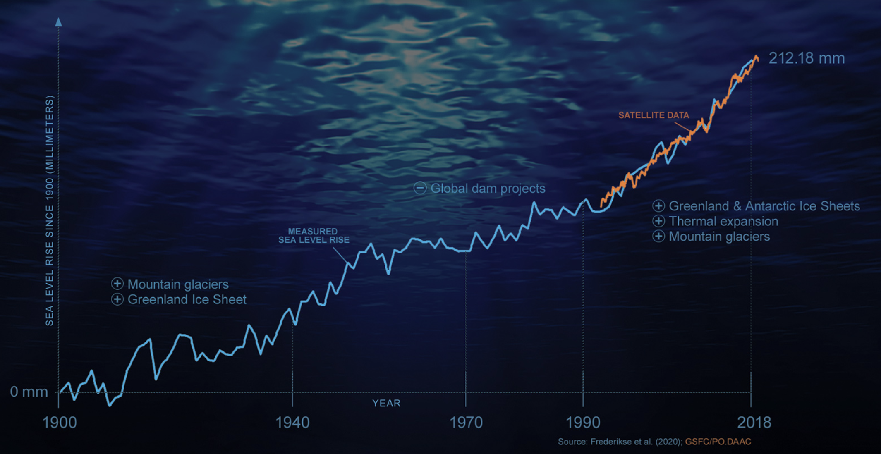
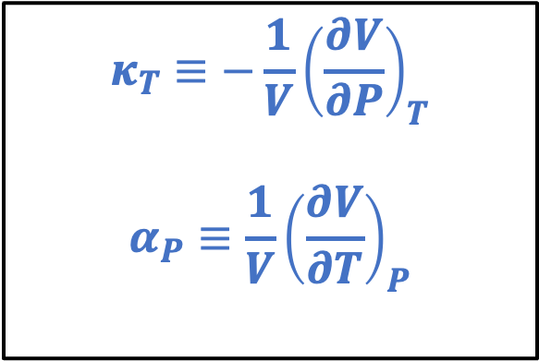
Recap: The “Isobaric expansivity” ($α_{P}$) and the “Isothermal compressibility” ($κ_{T}$)
$$κ_{T}≡−\frac{1}{V}{\left(\frac{∂V}{∂P}\right)}_{T}$$
$$α_{P}≡\frac{1}{V}{\left(\frac{∂V}{∂T}\right)}_{P}$$

Slide 4

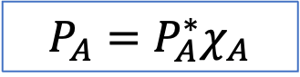


Recap: Raoult’s Law
P
A(g)
${P_{A}=P}_{A}^{∗}χ_{A}$
New equilibrium
A
$$P_{A}^{∗}$$
B
A
A
A
A
Solvent A with solute B
B
$$P_{A}$$
A
A
T
Here, $χ_{A}$ is the mole fraction of solvent A in the solution,
$χ_{A}≡\frac{n_{A}}{n_{A}+n_{B}}$. A handy formula: $χ_{A}=\frac{1}{1+M_{A}b_{B}}$ where $b_{B}≡\frac{mol B}{kg A}$ is the solute’s molality.

Slide 5
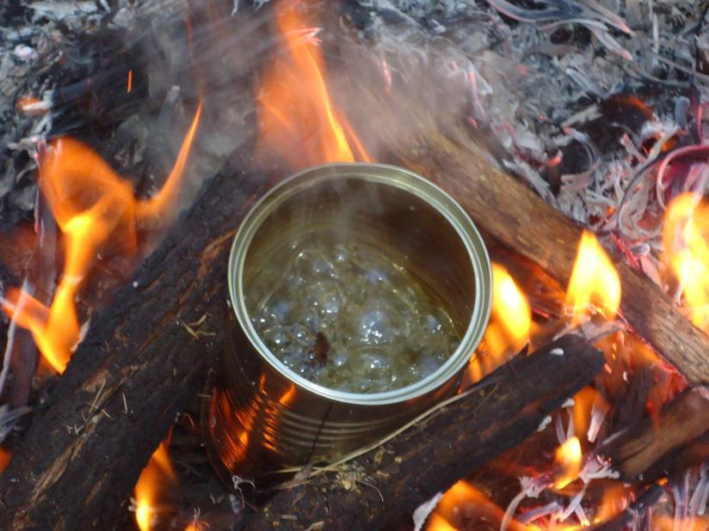
Recap: Boiling on Mt. Rainier
P
Atmospheric pressure
On Mt. Rainier
Boiling happens at a lower temperature on Mt. Rainier because atmospheric pressure is lower there.
T

Slide 6
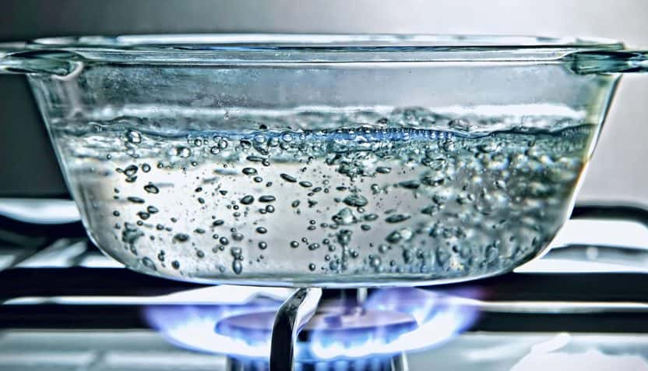


Recap: How Raoult explains why salty water boils at a higher temperature
P
$$P_{H_{2}O}^{∗}$$
Standard atmospheric pressure
NaCl
$$P_{H_{2}O}^{∗}χ_{H_{2}O}$$
T
If you add salt to boiling water, it’ll stop boiling (for a moment, anyway) because ${P_{H_{2}O}^{∗}χ_{H_{2}O}<P}_{H_{2}O}^{∗}$.
With the burner on, the temperature will go up until $P_{H_{2}O}^{∗}χ_{H_{2}O}$ reaches atmospheric pressure again.

Slide 7
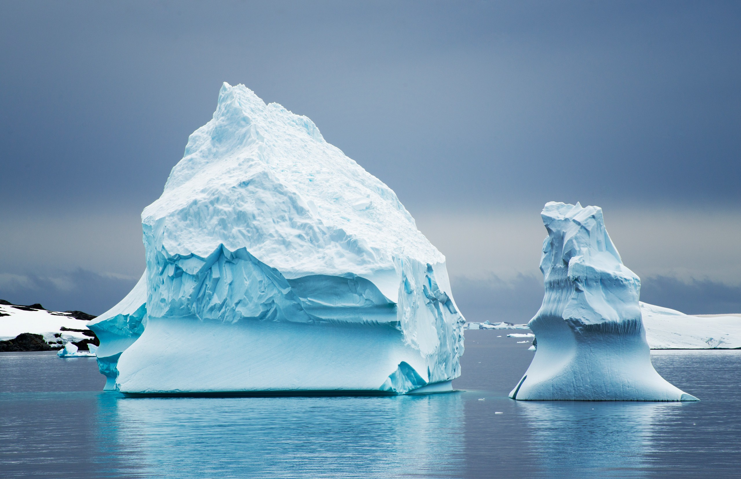

Recap: How Raoult explains freezing point depression
P
$$P_{A}^{∗}$$
$$P_{A}$$
$$∆T_{F}$$
T

Slide 8

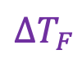
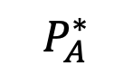
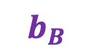
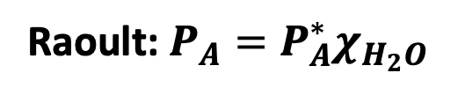
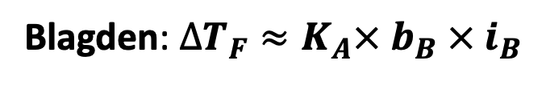
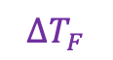
Recap: The connection between Raoult and Blagden
P
Raoult: $P_{A}=P_{A}^{∗}χ_{H_{2}O}$
$∆T_{F}$
Blagden: $∆T_{F}≈K_{A}× b_{B} × i_{B}$
$$P_{A}^{∗}$$
$$P_{A}$$
$$b_{B}$$
$$∆T_{F}$$
T

Slide 9

Why it’s reasonable to guess that $K_{A}∝\frac{1}{∆H_{fus}}$
P
Raoult: $P_{A}=P_{A}^{∗}χ_{H_{2}O}$
$∆T_{F}$
Blagden: $∆T_{F}≈K_{A}× b_{B} × i_{B}$
$$P_{A}^{∗}$$
$$P_{A}$$
$$b_{B}$$
$$∆T_{F}$$
T

Slide 10
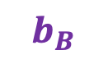
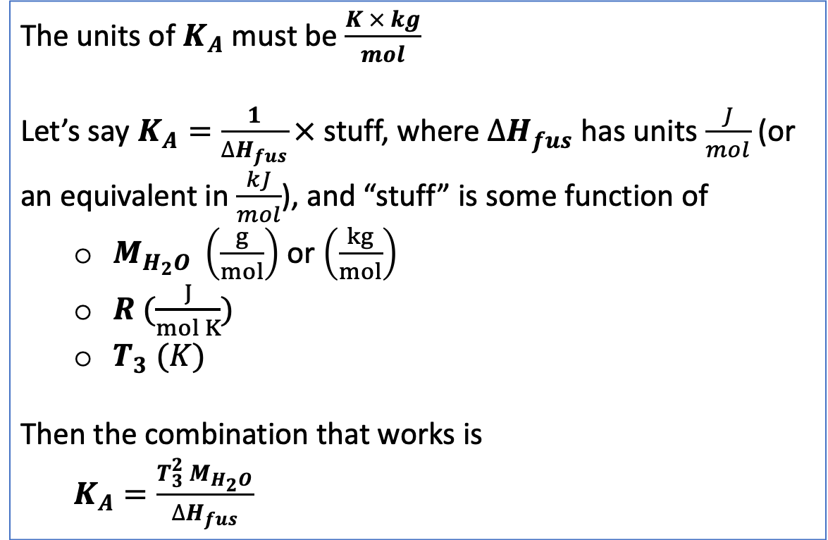
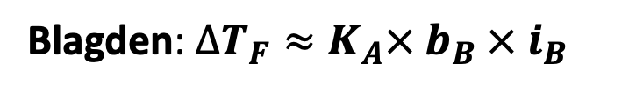
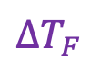
Getting $K_{A}$ by dimensional analysis
The units of $K_{A}$must be $\frac{K × kg}{mol}$
Let’s say $K_{A}=\frac{1}{∆H_{fus}}×$ stuff, where $∆H_{fus}$ has units $\frac{J}{mol}$ (or an equivalent in $\frac{kJ}{mol}$), and “stuff” is some function of
$M_{H_{2}O} \left(\frac{g}{mol}\right)$ or $\left(\frac{kg}{mol}\right)$
$R (\frac{J}{mol K})$
$T_{3} (K)$
Then the combination that works is
$K_{A}=\frac{T_{3}^{2} M_{H_{2}O}}{∆H_{fus}}$
Blagden: $∆T_{F}≈K_{A}× b_{B} × i_{B}$
$∆T_{F}$
$$b_{B}$$

Slide 11

Getting $K_{A}$ by dimensional analysis
The units of $K_{A}$must be $\frac{K × kg}{mol}$
Let’s say $K_{A}=\frac{1}{∆H_{fus}}×$ stuff, where $∆H_{fus}$ has units $\frac{J}{mol}$ (or an equivalent in $\frac{kJ}{mol}$), and “stuff” is some function of
$M_{H_{2}O} \left(\frac{g}{mol}\right)$ or $\left(\frac{kg}{mol}\right)$
$R (\frac{J}{mol K})$
$T_{3} (K)$
Then the combination that works is
$K_{A}=\frac{{R T}_{3}^{2} M_{H_{2}O}}{∆H_{fus}}$ $=1.86\frac{K × kg}{mol}$
Blagden: $∆T_{F}≈K_{A}× b_{B} × i_{B}$
$∆T_{F}$
$$b_{B}$$

Slide 12
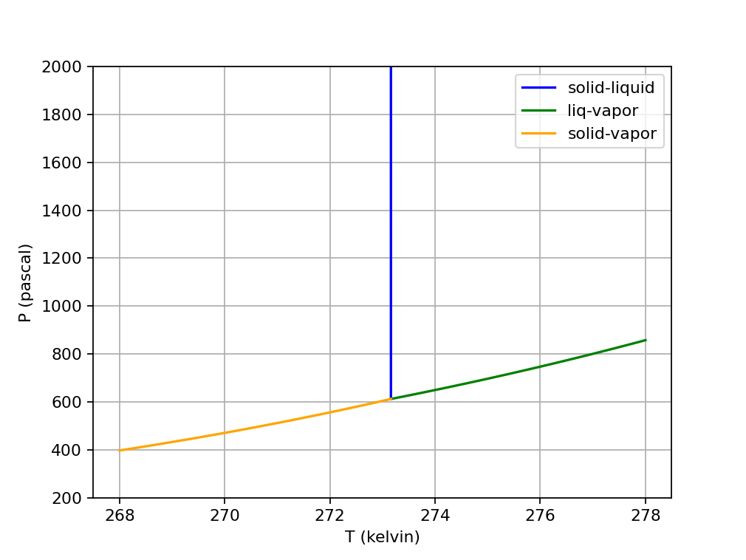
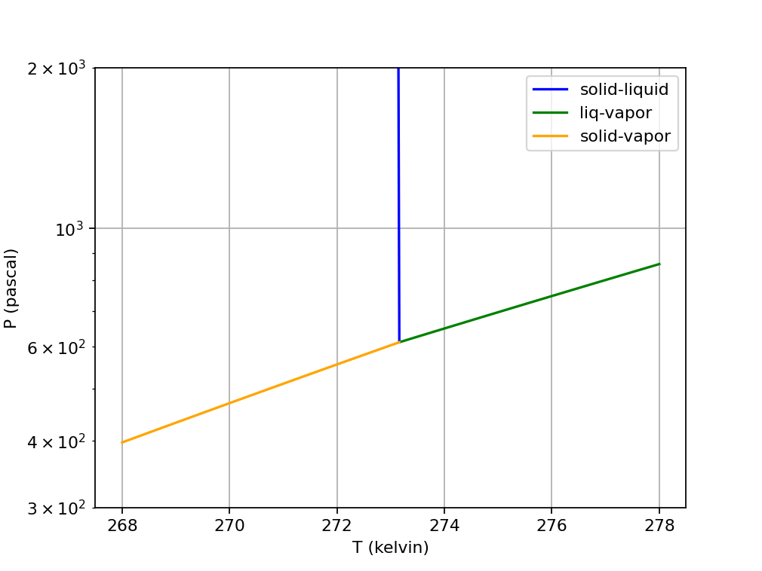
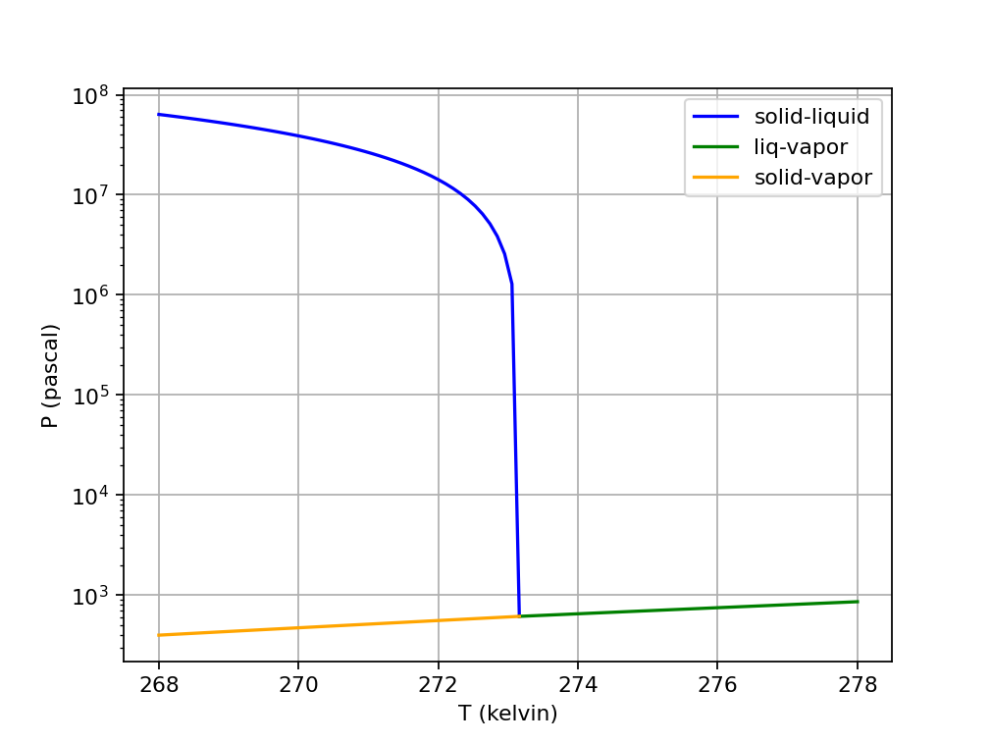
How phase diagrams look different depending on how you plot them
Linear in x & y
y-axis limited to 300-2000
Semilogy
y-axis limited to 300-2000
Semilogy
No limits on y-axis

Slide 13
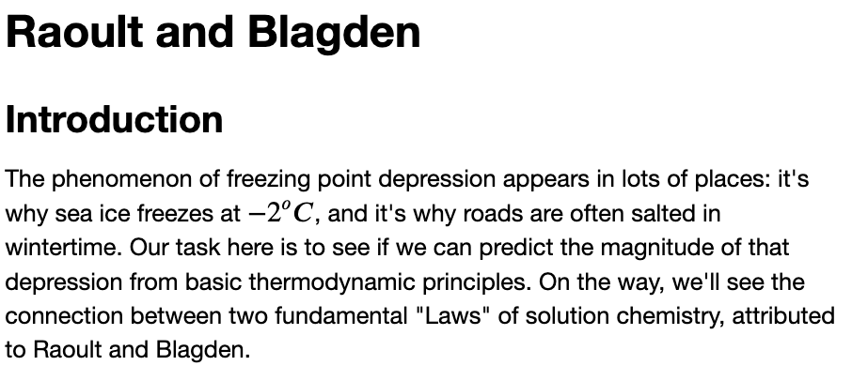
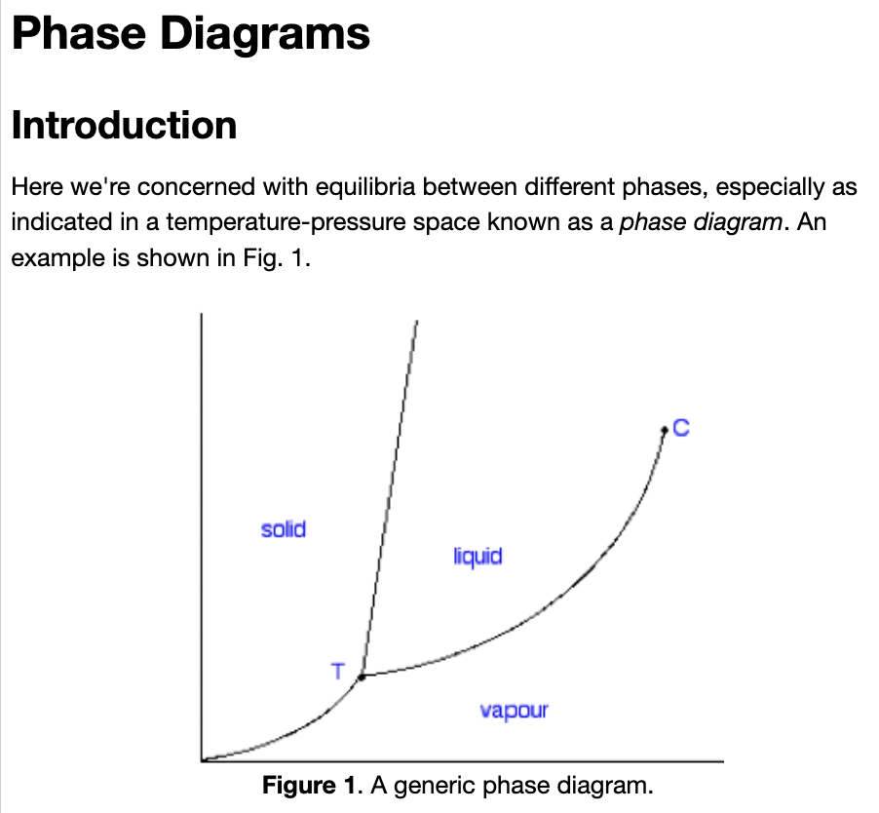
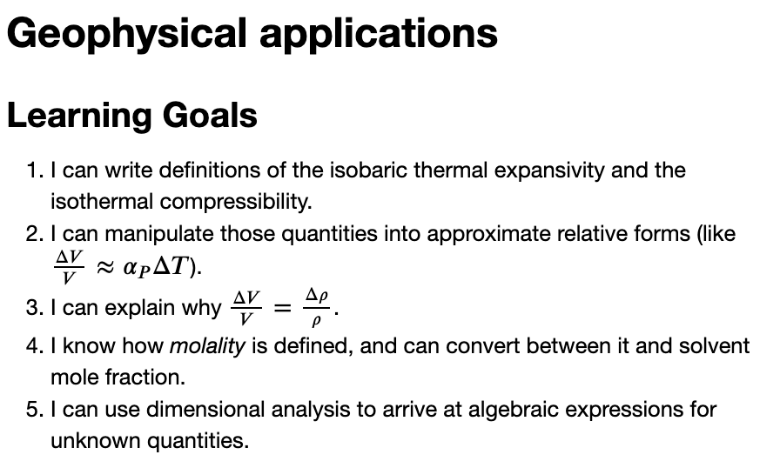
Wrapping up any remaining CGIs from this week

